Slide 1
Maori Game Documentation
Kavin Balakrishnan

Slide 2
Maori Game
Link to GitHub Repository: https://github.com/OnlyNoodles/Maori_Game
Links to Trello board / project management tools: https://trello.com/b/7pqfOIlg/maori-game-assessment
Link to final version of your program: https://github.com/OnlyNoodles/Maori_Game/blob/main/maori_game_base_v3.py
Ensure you have made these links ‘public’ so that they are open to anyone, including the marker. The link to your program is the final outcome of this whole project – your finished program.

Slide 3
Describe relevant Implications:
Relevant implication | Describe the implication and give an example
Social | The social implications are relevant because of the effect my code might have on society. This includes users, the wider community, and society as a whole. This includes racism and offensive content that would have a negative impact on society. Any messages and instructions in my program should be culturally neutral and inoffensive, which means being clear and unambiguous.
Future Proofing | If a future coder were to ever modify my program, I need to make sure that my code is flexible, adaptable, and easy to understand. My code should have comments such as doc-strings and a reasoning to why this part of the code exists and its purpose. It should also be well organised in some sense to make it easy to read.
Functionality | Functionality is about ensuring that the program works as expected. It should work for expected, boundary, and unexpected cases. This means making sure it works in all circumstances without error or crashing.
Usability | For the end user to read the end of the program with ease, they need to properly understand what to do. This is where usability comes into play. A good way to overcome this relevant implication is to include instructions and messages that are easy to understand.
Notes:
Additional rows can be added by clicking in the last cell and then using the Tab key

Slide 4
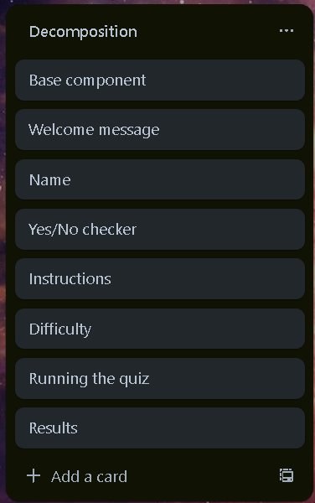
Decomposition:
Paste screenshots of your initial Trello board / task decomposition on this slide. If you have a long list, you might need to break it up into several slides.
Welcome Screen
Name
Yes/No checker
Instructions
Difficulty
Running the quiz
Results
Notes:
Paste screenshots of your initial Trello board / task decomposition on this slide. If you have a long list, you might need to break it up into several slides.

Slide 5
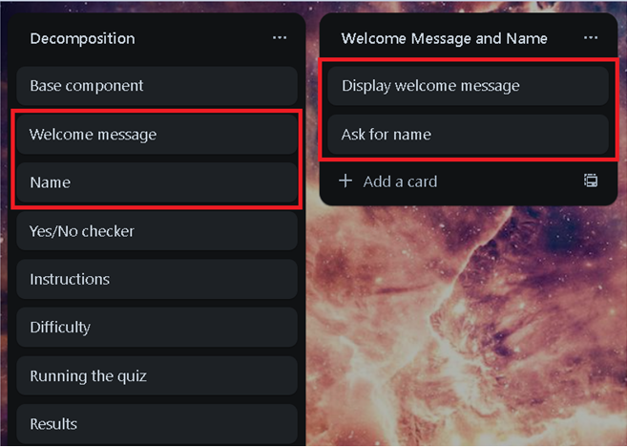
Component 1: Welcome Message and Name

Slide 6
Welcome Message and Name - Test Plan
Test Cases - input | Expected output
Run program | ---Welcome to the Maori Number Quiz--- Please enter your name:
{name} | Welcome to the Maori Number Quiz, {name}!
Notes:
Additional rows can be added by clicking in the last cell and then using the Tab key

Slide 7
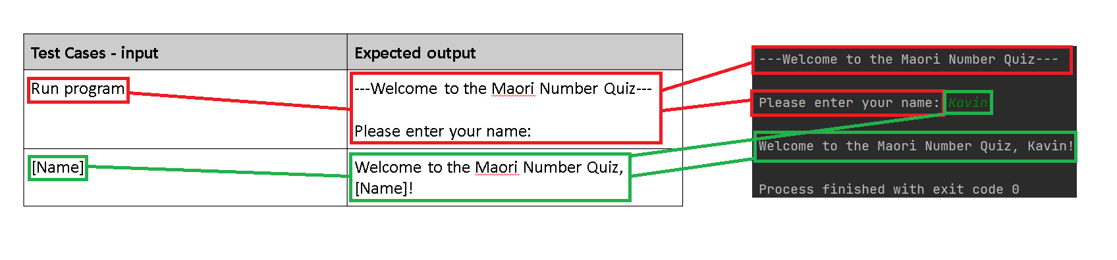
Welcome Message and Name: Testing
Welcome Message and Name component works as expected.
Notes:
You must show the results of testing. For each component, include a screenshot proving it works. You can also include notes about each test.

Slide 8
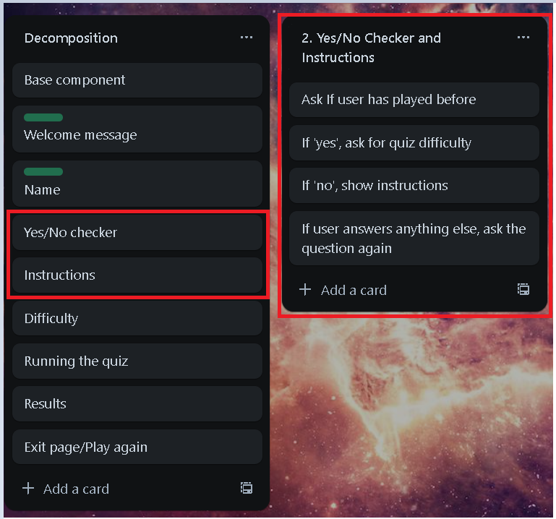
Component 2: Yes/No Checker and Instructions

Slide 9
Yes/No Checker and Instructions - Test Plan
Test Cases - input | Expected output
Yes | Program continues
Y | Program continues
yes | Program continues
No | Instructions
N | Instructions
no | Instructions
Maybe | Please answer ‘yes’ or ‘no’.
Notes:
Additional rows can be added by clicking in the last cell and then using the Tab key

Slide 10
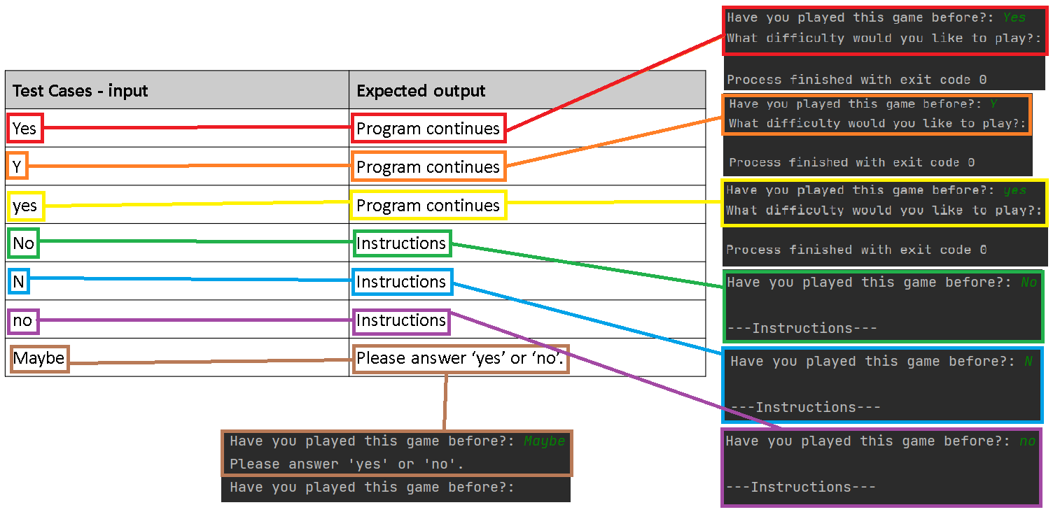
Yes/No Checker and Instructions: Testing
Yes/No Checker works as expected along with the instructions showing when the user answers ‘no’ and not showing when user answers ‘yes’.
Notes:
NOTE: Trialling needs to happen for at least 2 of your components but is not necessary for ALL components.
Trialling is not the same as testing. Trialling is about finding different ways of building the same component. Show evidence of your trialling here. Select one of your trials for further development and give reasons for your choice.

Slide 11
Yes/No Checker and Instructions - Trialling
Test Cases - input | Expected output
02_yes_no_checker_instructions_v1 | Program works but requires user to only answer ‘Yes’, ‘yes’, ‘y’, ‘No’, ‘no’, and ‘n’.
02_yes_no_checker_instructions_v2 | Changed the input so that the program will force the users answer into lowercase. This is so the program can accept answers such as ‘YES’ and ‘NO’.
02_yes_no_checker_instructions_v3 | Puts the Yes/No Checker into a loop that will keep asking the user if the user if they do not type an acceptable answer. The loop will be broken when the user answers ‘yes’, ‘y’, ‘no’, or ‘n’.
02_yes_no_checker_instructions_v4 | Incorporates yes_no_checker_instructions_v3 into a function. This will make it easy to recycle and use in other programs that will require a Yes/No Checker. Also added a set of instructions for user who answer ‘no’ or ‘n’. This is the version I will use in my final program.
Notes:
Additional rows can be added by clicking in the last cell and then using the Tab key

Slide 12
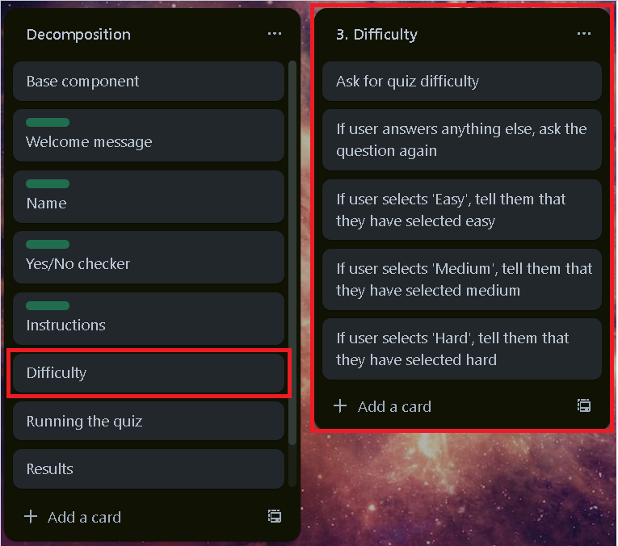
Component 3: Difficulty

Slide 13
Difficulty - Test Plan
Test Cases - input | Expected output
Easy | Difficulty: Easy Press <enter> to start!
easy | Difficulty: Easy Press <enter> to start!
Medium | Difficulty: Medium Press <enter> to start!
medium | Difficulty: Medium Press <enter> to start
Hard | Difficulty: Hard Press <enter> to start
hard | Difficulty: Hard Press <enter> to start
Any other answer | Difficulty has been automatically set to easy. Press <enter> to start
Notes:
Additional rows can be added by clicking in the last cell and then using the Tab key

Slide 14
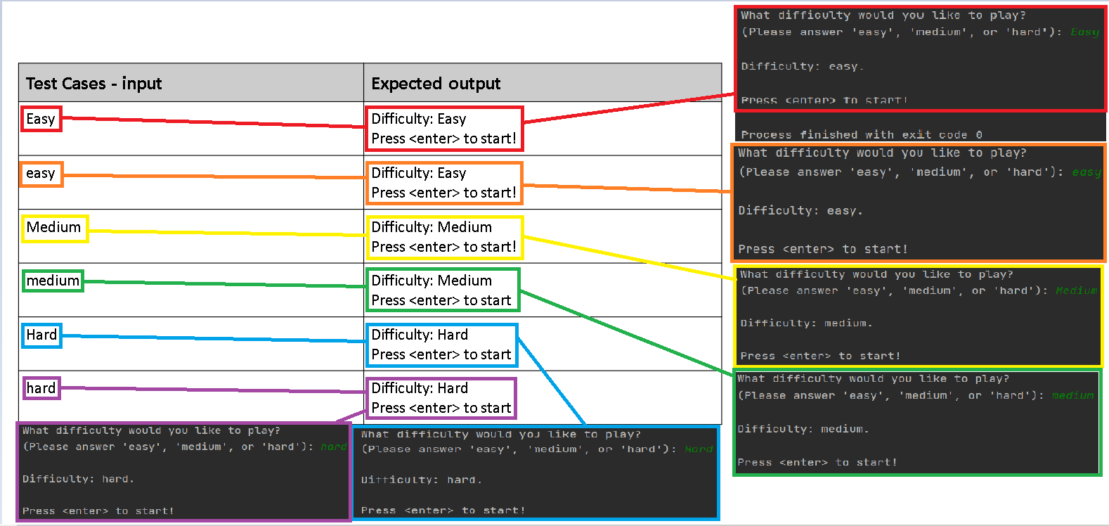
Difficulty: Testing
Notes:
You must show the results of testing. For each component, include a screenshot proving it works. You can also include notes about each test.

Slide 15
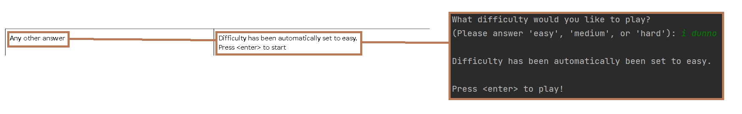
Difficulty: Testing - Continued
Difficulty selection component works properly and avoids errors.
Notes:
You must show the results of testing. For each component, include a screenshot proving it works. You can also include notes about each test.

Slide 16
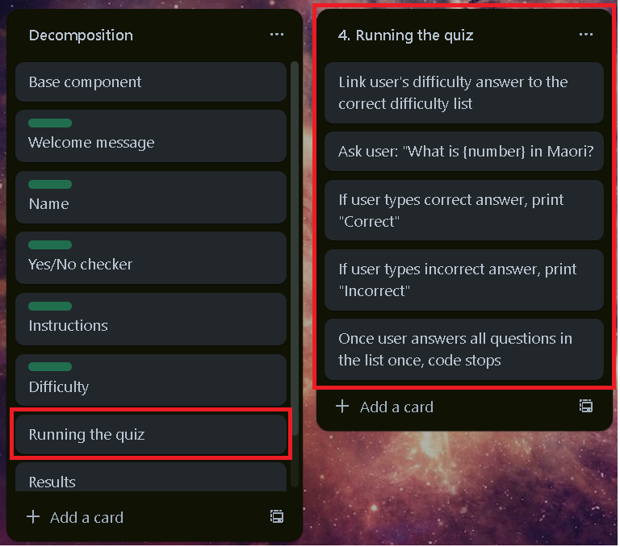
Component 4: Running the quiz

Slide 17
Running the quiz - Test Plan
Test Cases - input | Expected output
<enter> | What is {number according to difficulty, e.g. Hard: 23} in Maori?
Correct answer e.g. rua tekau ma toru | Correct
Incorrect answer e.g. rua tekau ma rua | Incorrect
Correct answer for last number that hasn’t been questioned | Correct Process finished with exit code 0
Incorrect answer for number that hasn’t been questioned | Incorrect Process finished with exit code 0
Notes:
Additional rows can be added by clicking in the last cell and then using the Tab key

Slide 18
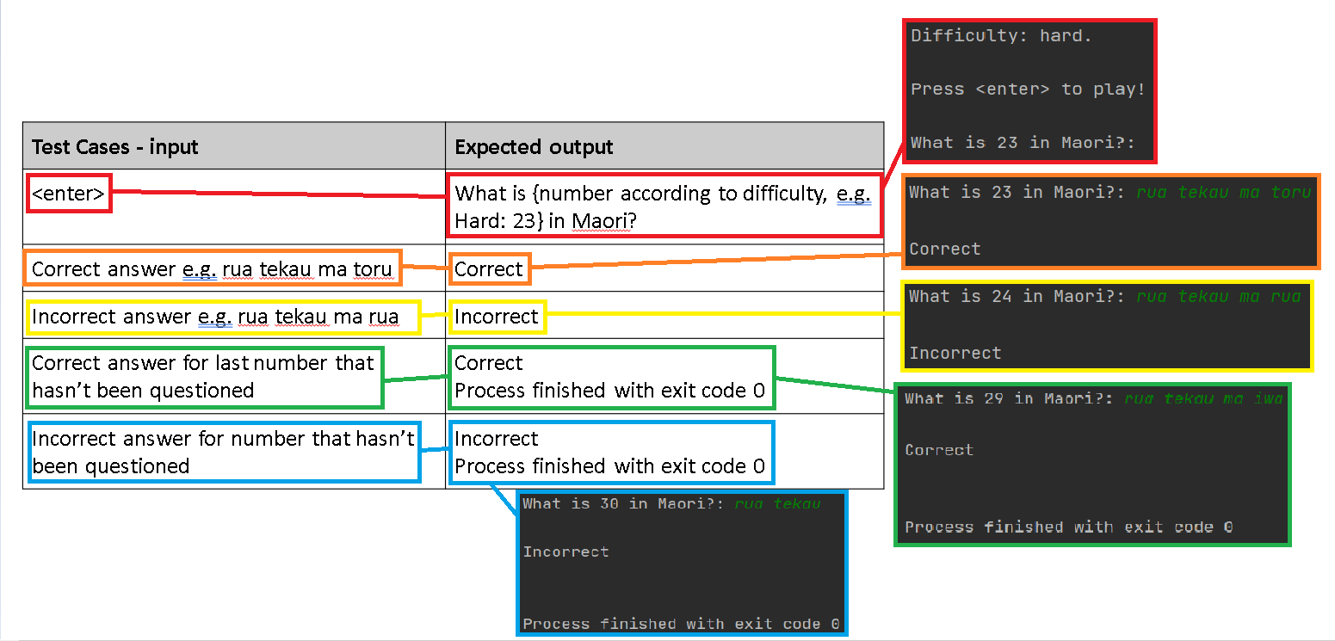
Running the quiz: Testing
The quiz component of the program works as intended.
Notes:
You must show the results of testing. For each component, include a screenshot proving it works. You can also include notes about each test.

Slide 19
Yes/No Checker and Instructions - Trialling
Test Cases - input | Expected output
04_game_v1 | Whenever I selected a difficulty, the code would just end, and the game function wouldn’t be read by the program.
04_game_v2 | I tried to make a game version where there were no difficulty options, but I decided to scrap that idea.
04_game_v3 | I changed the difficulty function a bunch of ‘if’, ‘elif’, and ‘else’ statements so that the code can link the correct list to the user’s answer. This way, the code knows which list to get questions from to give to the user. This is the code that I will be using in my base code.
04_game_v4 | I tried making the difficulty component into a ‘while’ loop while keeping the game component the same. Unfortunately, this version was unsuccessful since the program output asked the difficulty question again despite me answering the difficulty question before. To break the loop, I had to answer anything except ‘easy’, ‘medium’, and ‘hard’, so I decided to not use this version.
Notes:
Additional rows can be added by clicking in the last cell and then using the Tab key

Slide 20
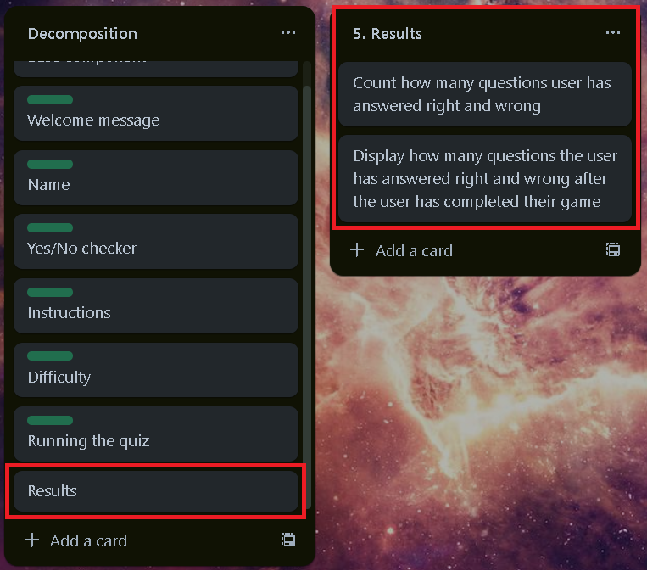
Component 5: Results

Slide 21
Results- Test Plan
Test Cases - input | Expected output
Answer for last number that hasn’t been questioned | --- Results --- You got {how many right) out of 10!
Notes:
Additional rows can be added by clicking in the last cell and then using the Tab key

Slide 22
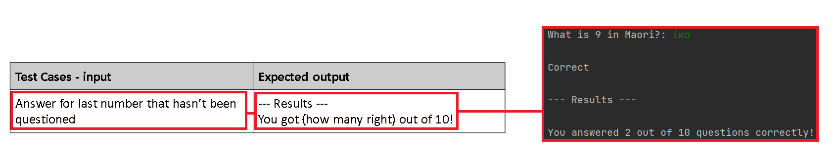
Results: Testing
Results component outputs results as expected.
Notes:
You must show the results of testing. For each component, include a screenshot proving it works. You can also include notes about each test.

Slide 23
Assembled Outcome - Test Plan 1
Test Cases - input | Expected output
Run program | --- Welcome to the Beginners Maori Number Quiz! --- Please enter your name:
{Enters name} | Welcome to the Beginners Maori Number Quiz, {name}! Have you played this game before? (Please answer ‘yes’ or ‘no’):
yes | What difficulty would you like to play?:
no | --- Instructions --- … What difficulty would you like to play?:
Any other answer | Please answer ‘yes’ or ‘no’. What difficulty would you like to play? (Please answer ‘yes’ or ‘no’):
Notes:
Additional rows can be added by clicking in the last cell and then using the Tab key

Slide 24
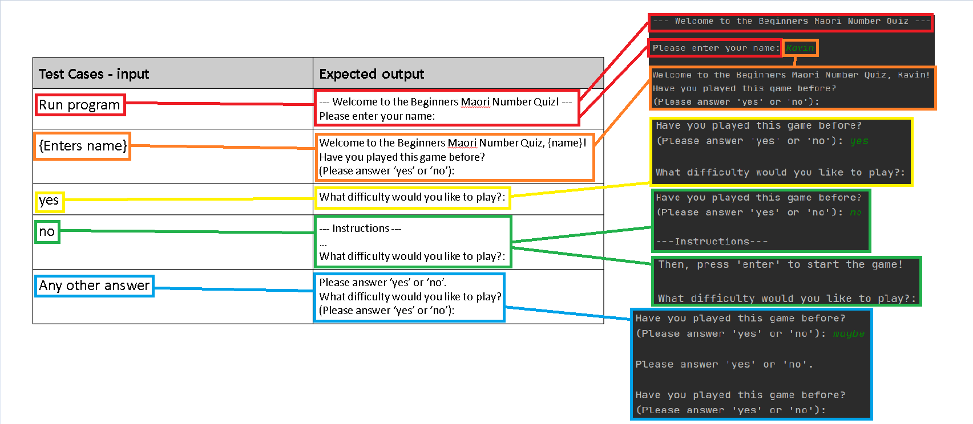
Assembled Outcome - Testing 1
Notes:
Show testing for your assembled outcome below. This should include a test plan followed by screenshot proof.

Slide 25
Assembled Outcome - Test Plan 2
Test Cases - input | Expected output
easy | Difficulty: easy. Press <enter> to start!
1 | Difficulty: easy. Press <enter> to start!
medium | Difficulty: medium. Press <enter> to start!
2 | Difficulty: medium. Press <enter> to start!
hard | Difficulty: hard. Press <enter> to start!
3 | Difficulty: hard. Press <enter> to start!
Any other answer | Difficulty has been automatically set to easy,. Press <enter> to start!
Notes:
Additional rows can be added by clicking in the last cell and then using the Tab key

Slide 26
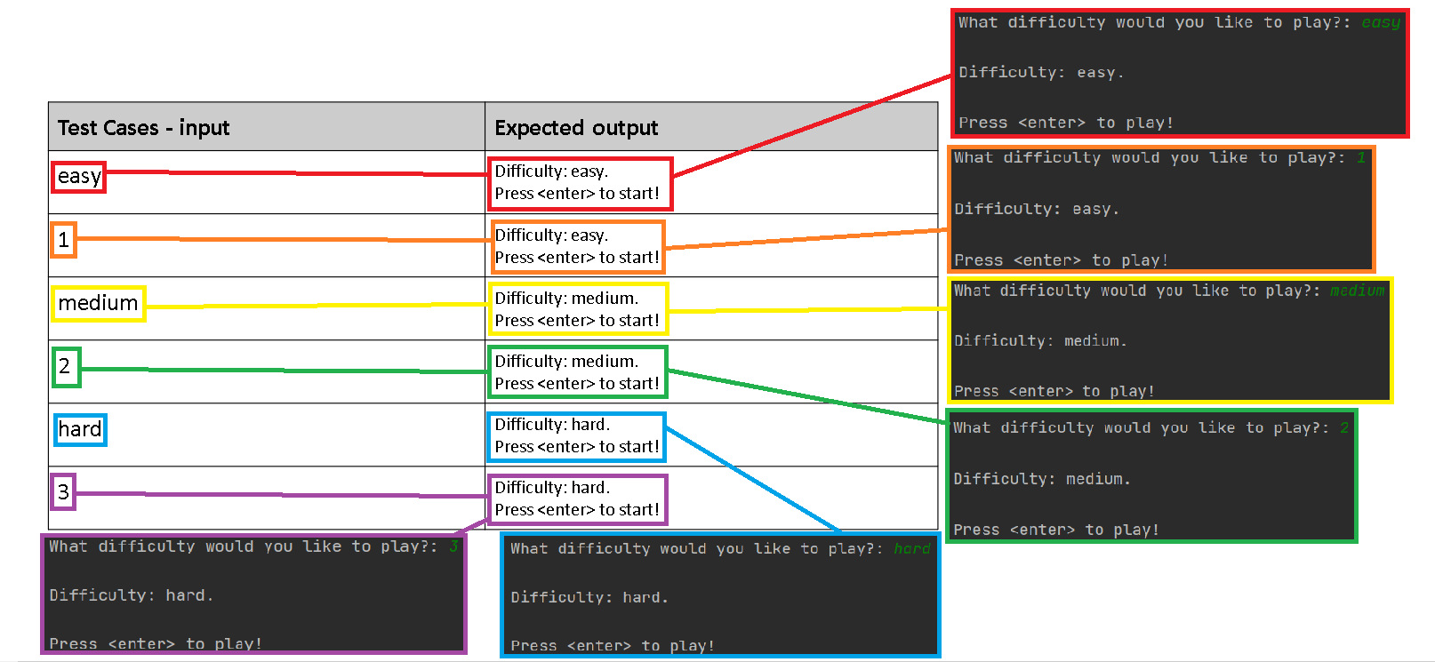
Assembled Outcome - Testing 2
Notes:
Show testing for your assembled outcome below. This should include a test plan followed by screenshot proof.

Slide 27
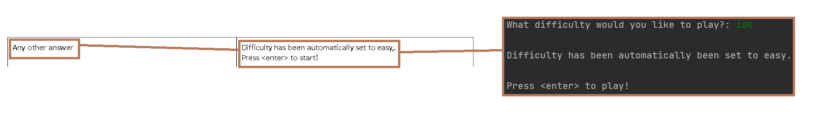
Assembled Outcome - Testing 2 continued
Notes:
Show testing for your assembled outcome below. This should include a test plan followed by screenshot proof.

Slide 28
Assembled Outcome - Test Plan 3
Test Cases - input | Expected output
<enter> | What is {number from preferred list} in Maori?:
{correct answer} | Correct What is {another number from same list} in Maori?:
{incorrect answer} | Incorrect What is {another number from same list} in Maori?:
{correct answer for last question} | Correct --- Results --- You answered {how many right} out of 10 questions correctly!
{Incorrect answer for last question} | Incorrect --- Results --- You answered {how many right} out of 10 questions correctly!
Notes:
Additional rows can be added by clicking in the last cell and then using the Tab key

Slide 29
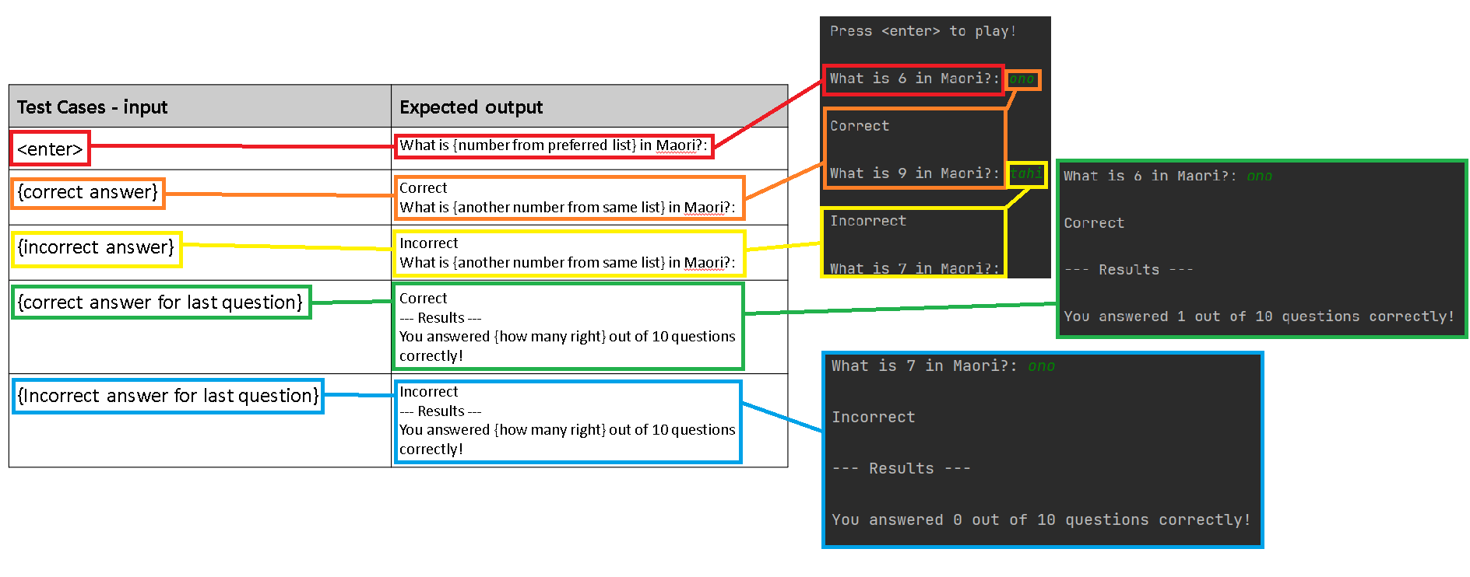
Assembled Outcome - Testing 3
Notes:
Show testing for your assembled outcome below. This should include a test plan followed by screenshot proof.

Slide 30
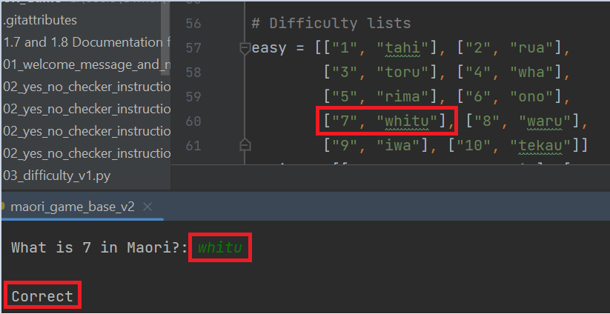
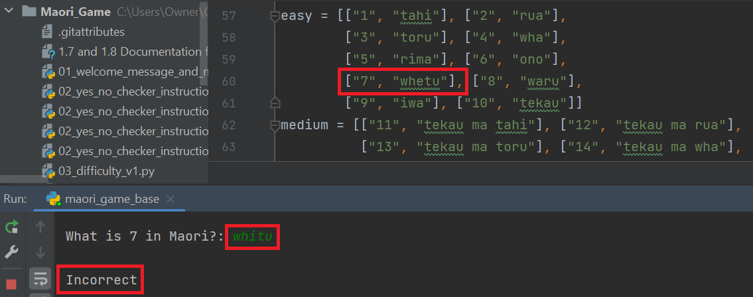
Assembled Outcome: User Feedback 1
Show testing for your assembled outcome below. This should include a test plan followed by screenshot proof.
I got Eleasha to test my program and she noticed a spelling error in ‘whitu’, which I had spelt as ‘whetu’. I then changed in a second version of the base code. This helped me stay true to the social implication of my code being offensive to certain social groups.
Notes:
Show testing for your assembled outcome below. This should include a test plan followed by screenshot proof.

Slide 31
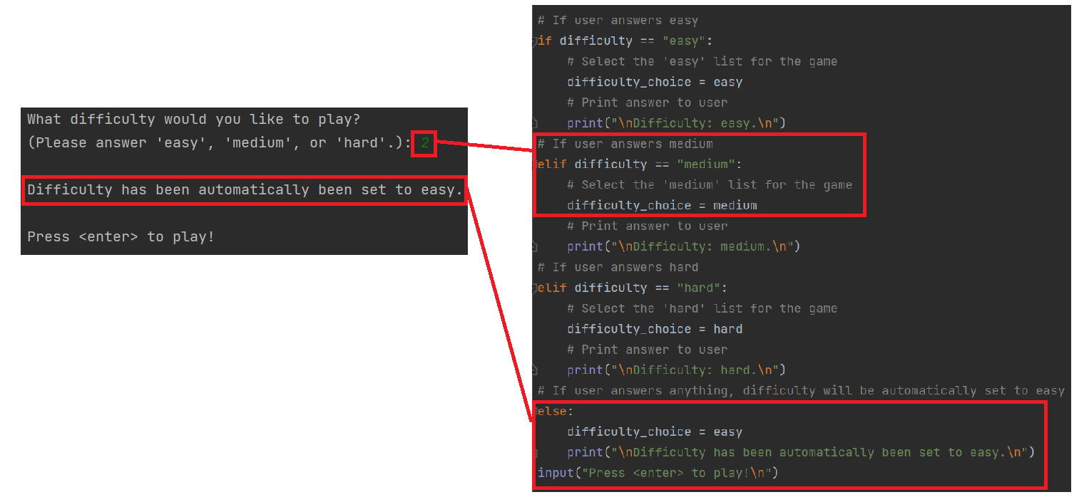
Assembled Outcome: User Feedback 2
I got my Dad to test my program and he recommended me to change the difficulty selector so that when the user answers ‘1’,
the program selects the ‘easy’ difficulty, while ‘2’ is the medium difficulty, and ‘3’ is the hard difficulty.
Notes:
Show testing for your assembled outcome below. This should include a test plan followed by screenshot proof.

Slide 32
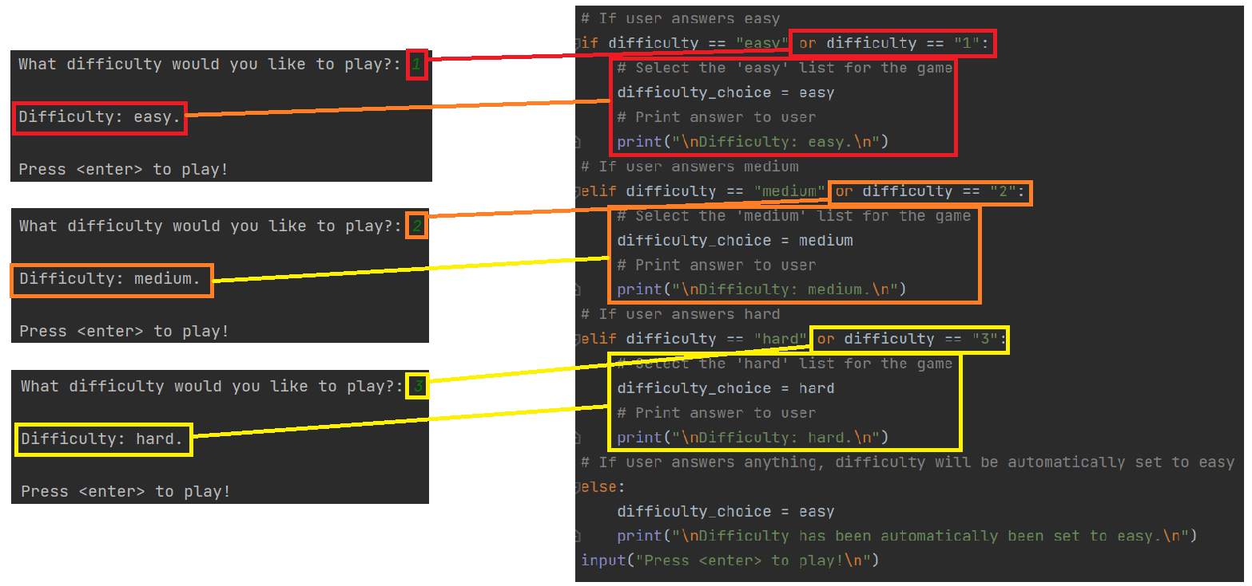
Assembled Outcome: User Feedback 2 continued
I then updated my code in a third version of the base code to adapt to my Dad’s feedback.
The third version is the final version of my code.
Notes:
Show testing for your assembled outcome below. This should include a test plan followed by screenshot proof.

Slide 33
Address relevant Implications:
Relevant implication | Explain how your final outcome addresses each implication
Social | I made sure to make my code appeal to all social groups in society, such as the users, the wider community, and society as a whole. I made sure to not include any racist and harmful comments in my program. An example of this is making sure the spelling for both English and Maori words are correct, and I also added Beginners in the welcome message component so that people will know that the reason why macrons aren’t needed is because it is a little more advanced than a beginner level.
Future proofing | I made sure to include doc-strings for parts of my code so that, if anyone were to edit my code for future circumstances, they would know which line of code’s purpose. I also organized the code well by spacing out each component for better readability.
Functionality | I have tested my code thoroughly to make sure it works, despite any circumstance. I’ve made sure that it doesn’t crash at random times while the program is running. This is to ensure that my code isn’t off-putting to the user when it crashes when they try to do something.
Usability | Ensuring the user can easily do the game and understand what to do is an important implication to consider. With this in mind, I made sure to include clear instructions for users who were new to my program and clear output messages to the user to avoid confusion.

Slide 34
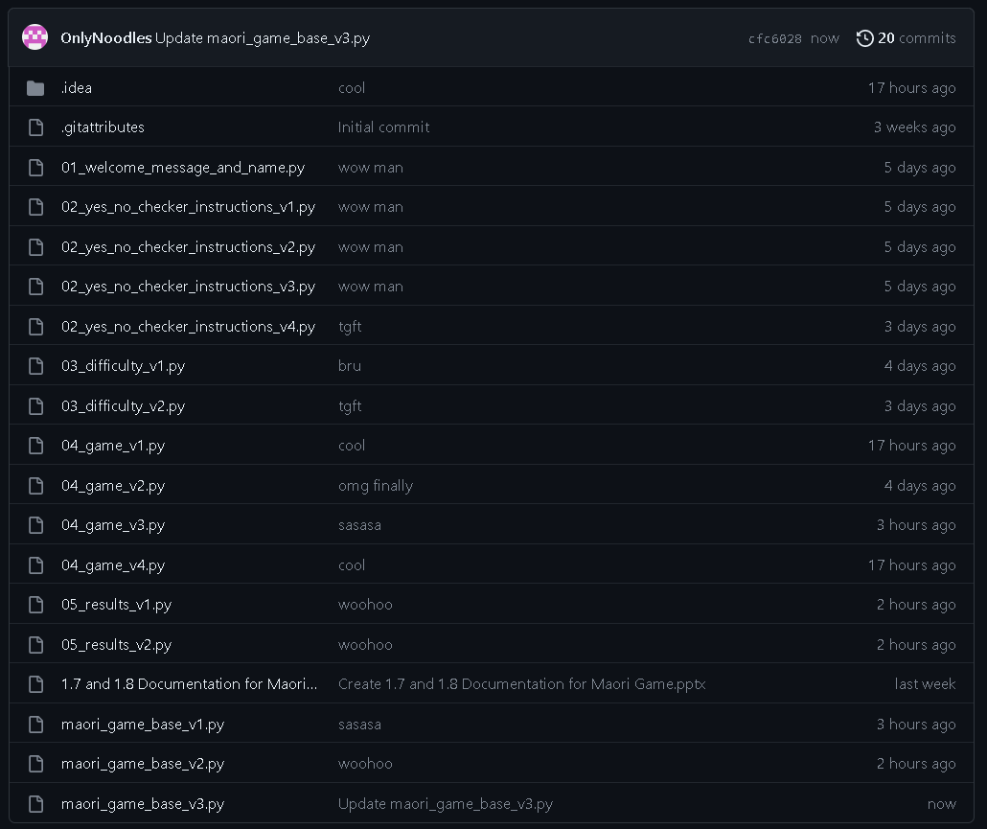
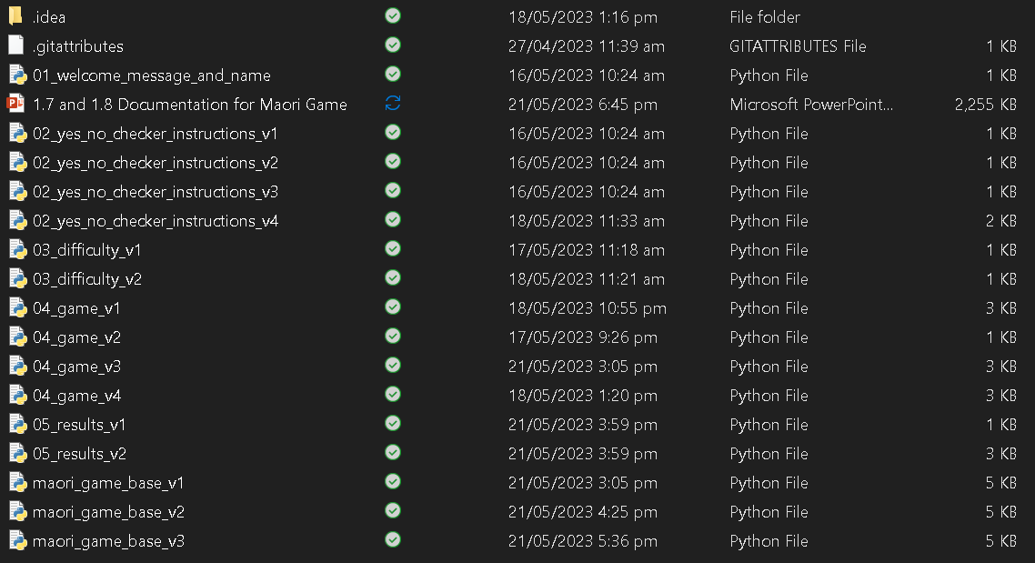
Version Control Evidence:
Notes:
Your version control evidence should go here. This could be in the form of screenshots (both of your GitHub repository as well as your local project folder) as evidence of your incremental development.

Slide 35
Final Discussion:
While developing this program, I planned and tested individual components, trialling two components, and then later as a whole working game.
Decomposing the problem helped me plan my program efficiently and make me able to focus on creating and testing small chunks of my code, with each chunk being a component of the program. Each of these components were thoroughly tested during and after assembly.
Testing helped me find and fix any errors in my program before combining them into the base program.
Having volunteers test my program enabled me to improve its functionality and usability from the first version of the base code. It helped me get ideas about how to make it better which raised the quality of the final version.
User feedback helped me look at the program from the end user’s point of view. This, along with the information I got from the earlier planning, testing, and trialling, helped me to produce a high-quality program.
I tested my code using the PyCharm PEP8 checker to make sure that it met the conventions regarding spacing and layout, though the PEP8 checker detects some Maori words as spelling errors and I have no way of avoiding this is as I must follow the social implications regarding being racist of disrespectful to Maori culture (see the next slide).
Notes:
Discuss how the information from planning, testing and trialling of components assisted in the development of a high-quality outcome.

Slide 36
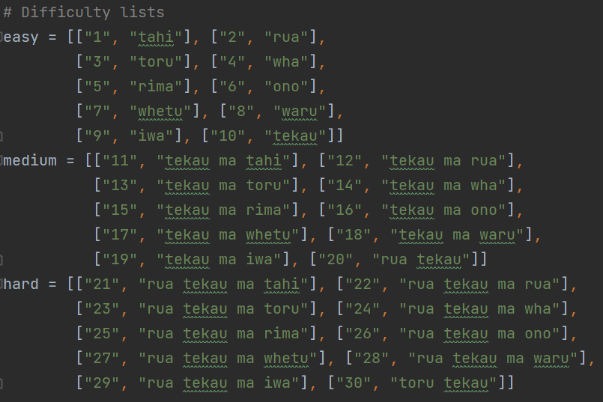
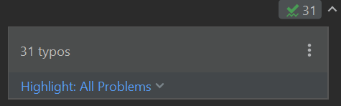
Evidence of Meeting PEP8 Requirements

